Slide 1
INVESTMENTS
Week 4: Asset Pricing Models 2
Vikas Raman

Slide 2
Outline
Equilibrium Models
Arbitrage Pricing Theory
Single Factor Model
Identification of Factors
Chen Ross and Roll Model
Fama and French Three-Factor Model
Different interpretations!
Carhart Four-Factor Model
APT v/s CAPM

Slide 3
Equilibrium Models
So far looked at equilibrium models
characterise demands of investors and find prices for securities that brings supply/demand equilibrium
but empirical results are disappointing
maybe we are being too ambitious given that demands are affected by complex factors
beliefs, fears, superstitions
different endowments, horizons and objectives
existence of substitutes (housing, human capital)
institutional frictions (herding, league tables)
Try a more limited approach: start with a simple description and then explore the impact of arbitrageurs (prices may not be right, but they should not allow easy certain profits)

Slide 4
Arbitrage Pricing Theory
An arbitrage opportunity arises when an investor can earn riskless profits without making a net investment.
The law of one price states that if two assets are equivalent in all economically relevant respects, then they should have the same market price.
During the arbitrage activity, investors will bid up the price where it is low and force it down where it is expensive. As a result they eliminate the arbitrage opportunities.
Security prices should satisfy a “no-arbitrage condition”.

Slide 5
Arbitrage Pricing Theory
APT (Ross, 1976) predicts a security market line as CAPM and shows a linear relation with expected return and risk.
According to APT:
Security returns are described by a factor model
There are sufficient securities to diversify away idiosyncratic risk
Well-functioning security markets do not allow for the persistence of arbitrage opportunities
There are no taxes.
There are no transaction costs.
Notice that there are considerably fewer than with the CAPM.

Slide 6
Single Factor Model
A first attempt at characterising behaviour of returns
use excess returns (ie actual – risk free rate) for ease
In SFM, assume return is a linear function of some factor common to all stocks, and idiosyncratic noise: so R_{i,t} = α_{i} + β_{i}F_{t} + e_{i,t}
β_{i} is a constant, measures i’s sensitivity to the factor F (will assume +ve);
E[e_{i,t}] = 0, so e is noise;
Cov[F_{t} , e_{i,t}] = 0, so e is idiosyncratic;
With F equal to the market return, this model is called the Market Model
Suppose we have enough history and the α’s and β’s are stable enough that we (and everyone else) can estimate them accurately: how would we make up a good portfolio? (assuming we want maximum return for minimum risk)

Slide 7
Optimum Portfolio
Obvious strategy:
the attractive shares are those that have a high α per unit of β – buy them
(short) sell the shares that have a low α per unit of β
ensure that you end up with zero beta net
end up with high alpha portfolio, no factor exposure, and just idiosyncratic risk
if you avoid putting too much in one share, you will have diversified away almost all the idiosyncratic risk
so you will have a staggeringly good deal!

Slide 8
Simple Example
1000 G shares with α = 6%, β = 1, and σ_{idio} = 20%
1000 B shares with α = 5%, β = 1, and σ_{idio} = 20%
I go short £1 of each of the B shares, and go long £1 each of the G shares
the portfolio’s beta = 0
the expected return is 6% on £1000 – 5% on £1000 = £10
this looks a fantastic deal
APT: securities must be priced such that these arbitrage strategies are not profitable.

Slide 9
Arbitrage Pricing Theory
APT: securities must be priced such that these arbitrage strategies are not profitable.
If all firms have the same α/β ratio, then the portfolio has the same ratio, so if you get rid of β you also lose α
and you have a relationship that looks like the CAPM:
R_{i,t} = α_{i} + β_{i}F_{t} + e_{i,t}
So, E[R_{i,t}] = α_{i} + β_{i} E[F_{t}]
but the α/β ratio is the same for all shares so α_{i} = kβ_{i} and
E[R_{i,t}] = β_{i} (k + E[F_{t}]) – the expected excess return on a share is proportional to its β

Slide 10
Arbitrage Pricing Theory
With lots of different shares, can create a portfolio that has very high alpha, very low risk unless there is a constant α/β ratio k_{n} for each of the N factors so that
This is the Arbitrage pricing theory

Slide 11
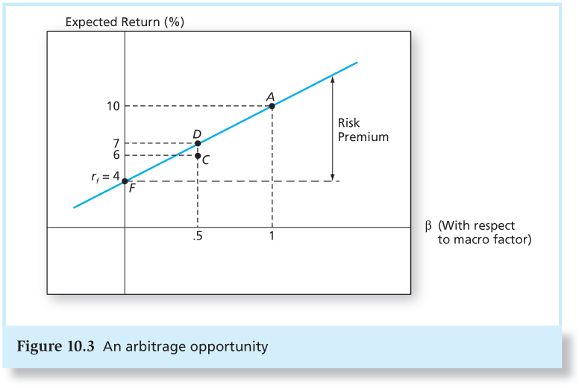
Arbitrage Pricing Theory
The risk-premiums of well-diversified portfolios with different betas should be proportional to their betas.
The expected return on all well-diversified portfolios must lie on the straight line from the risk-free asset.
The equation of the line will also show the expected return on all well-diversified portfolios.

Slide 12
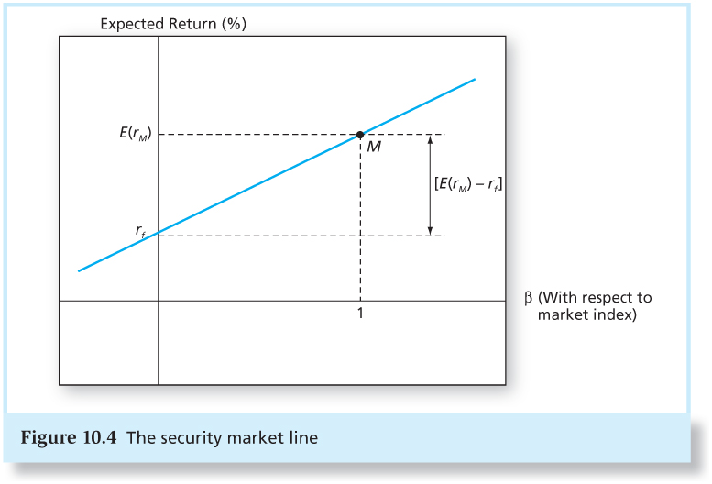
Arbitrage Pricing Theory
Take M, market index portfolio as a well-diversified portfolio.
Since M is well-diversified, should be on the line and its beta is 1.
Thus, the equation of the line is:
E[r_{Y}] = r_{f} + β(E[r_{M}] - r_{f})
The CAPM is an example of a one-factor APT model

Slide 13
Identification of factors
APT fails to offer any guidance on either the number of factors or their identity – they have to be estimated empirically
Can deduce the factors by doing a factor analysis on security returns
factor analysis finds the best groupings of securities that minimises the variance of residual returns
Roll and Ross (1980) identified at least three significant factors (using 42 portfolios of 30 US stocks, daily returns, 1962-72)
Alternatively, can pre-specify factors likely to be important. Chen, Roll and Ross (1986) suggest that four most important factors are the unanticipated changes in
inflation
slope of term structure (difference between long and short rates of interest)
risk premium on corporate debt (difference in yield between low and high grade debt)
industrial output.

Slide 14

Chen, Roll and Ross (1986)
The overall goal is to identify a set of macroeconomic factors associated with returns on financial assets.
The intuition: Chen, Roll, and Ross view an asset’s price P_{t} as a stream of expected cash flow, c_{t+1},c_{t+2},..., discounted at a rate k:
Thus, factors affecting price changes (or asset returns) should be those factors related to changes in expected cash flows or changes in discount rates.

Slide 15
Chen, Roll and Ross (1986)
The above reasoning leads to the following factors:
Change in industrial production (monthly (MP) and yearly (IP))
Inflation (unexpected (UI) and expected (EI))
Risk or default premium (Baa-gov bond returns) (UPR)
Term premium (long bond – T-bill) (UTS)
Market index (EWNY) and (VWNY)

Slide 16
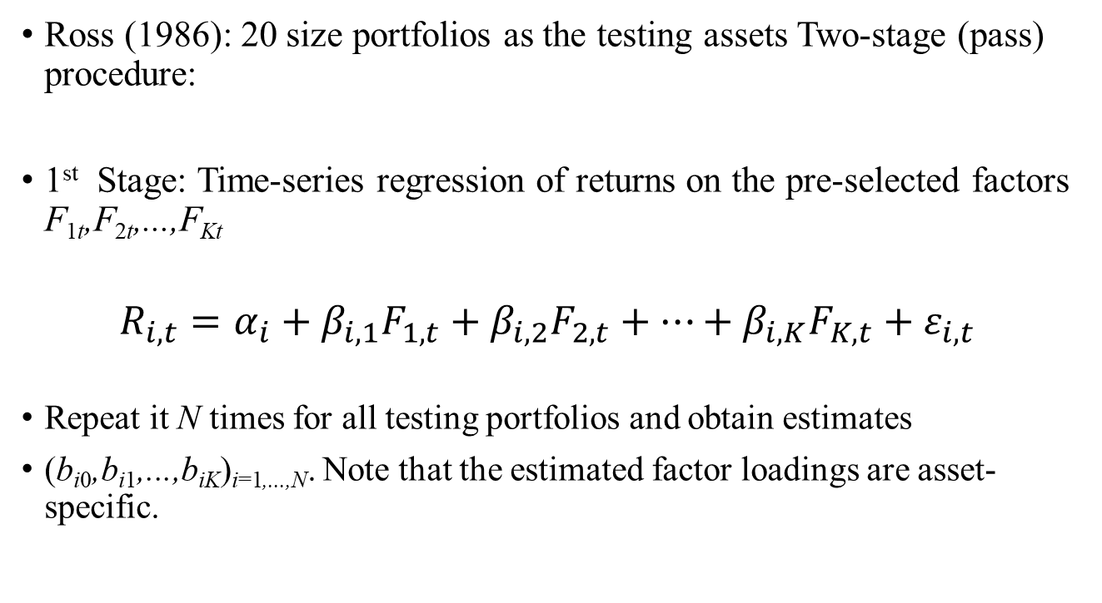
Chen, Roll and Ross (1986)
Ross (1986): 20 size portfolios as the testing assets Two-stage (pass) procedure:
1st Stage: Time-series regression of returns on the pre-selected factors F_{1t},F_{2t},...,F_{Kt}
$$R_{i,t}=α_{i}+β_{i,1}F_{1,t}+β_{i,2}F_{2,t}+…+β_{i,K}F_{K,t}+ε_{i,t}$$
Repeat it N times for all testing portfolios and obtain estimates
(b_{i0},b_{i1},...,b_{iK})_{i=1,...,N}. Note that the estimated factor loadings are asset-specific.

Slide 17
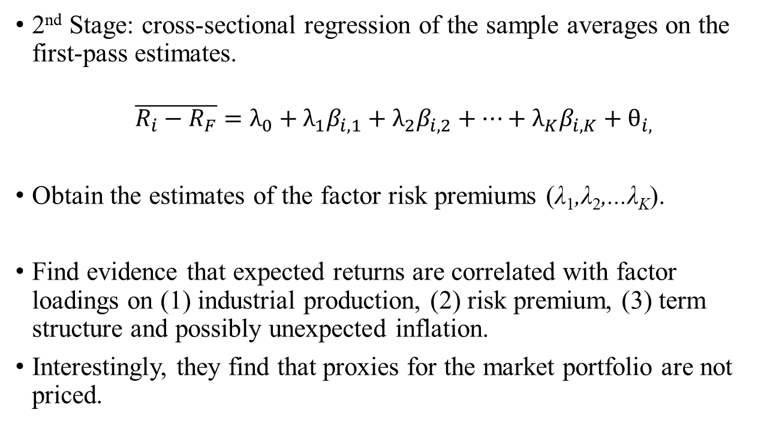
Chen, Roll and Ross (1986)
2nd Stage: cross-sectional regression of the sample averages on the first-pass estimates.
$$\overline{R_{i}−R_{F}}=λ_{0}+{λ_{1}β}_{i,1}+{λ_{2}β}_{i,2}+…+{λ_{K}β}_{i,K}+θ_{i,}$$
Obtain the estimates of the factor risk premiums (λ₁,λ₂,...λ_{K}).
Find evidence that expected returns are correlated with factor loadings on (1) industrial production, (2) risk premium, (3) term structure and possibly unexpected inflation.
Interestingly, they find that proxies for the market portfolio are not priced.

Slide 18
Chen, Roll and Ross (1986)

Slide 19
Fama and French Three-Factor Model
Three – factor empirical model (Fama and French ,1993)
Motivation:
Banz (1981): Firm size can explain the cross-section of average returns in addition to Beta.
Rosenberg, Reid, and Lanstein (1985): book-to-market equity (BE/ME) also has a strong role in explaining the cross-section of average returns.

Slide 20
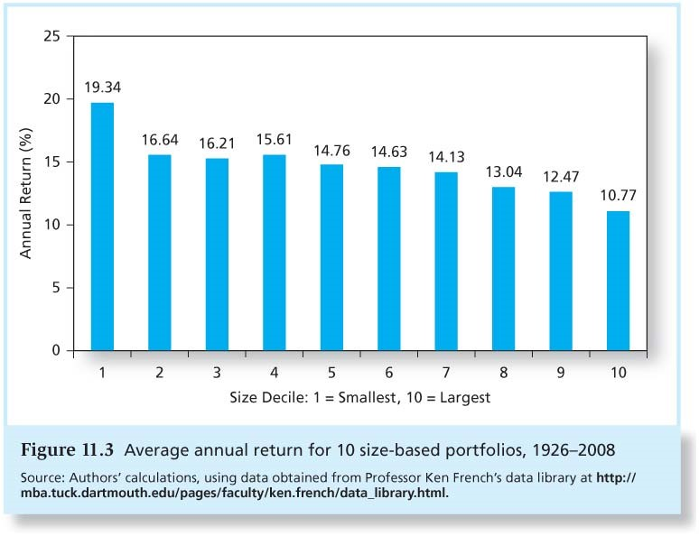
Fama and French Three-Factor Model
The Size Effect:

Slide 21
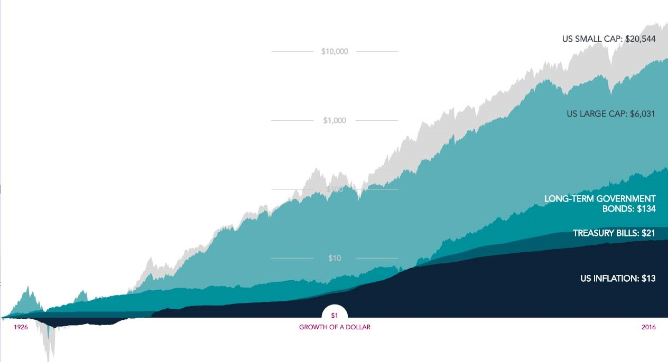
Fama and French Three-Factor Model
The Size Effect:
Source: Dimensional Fund Advisors

Slide 22
Fama and French Three-Factor Model
Value Stocks:
Stocks with high book-to-market ratio: Book-value-of-firm / market-value-of-firm
Growth (Glamour) Stocks:
Stocks with low book-to-market ratio.
Stocks with large growth in earnings and revenue. Typically pay small dividends – they use it to finance expansion instead.

Slide 23
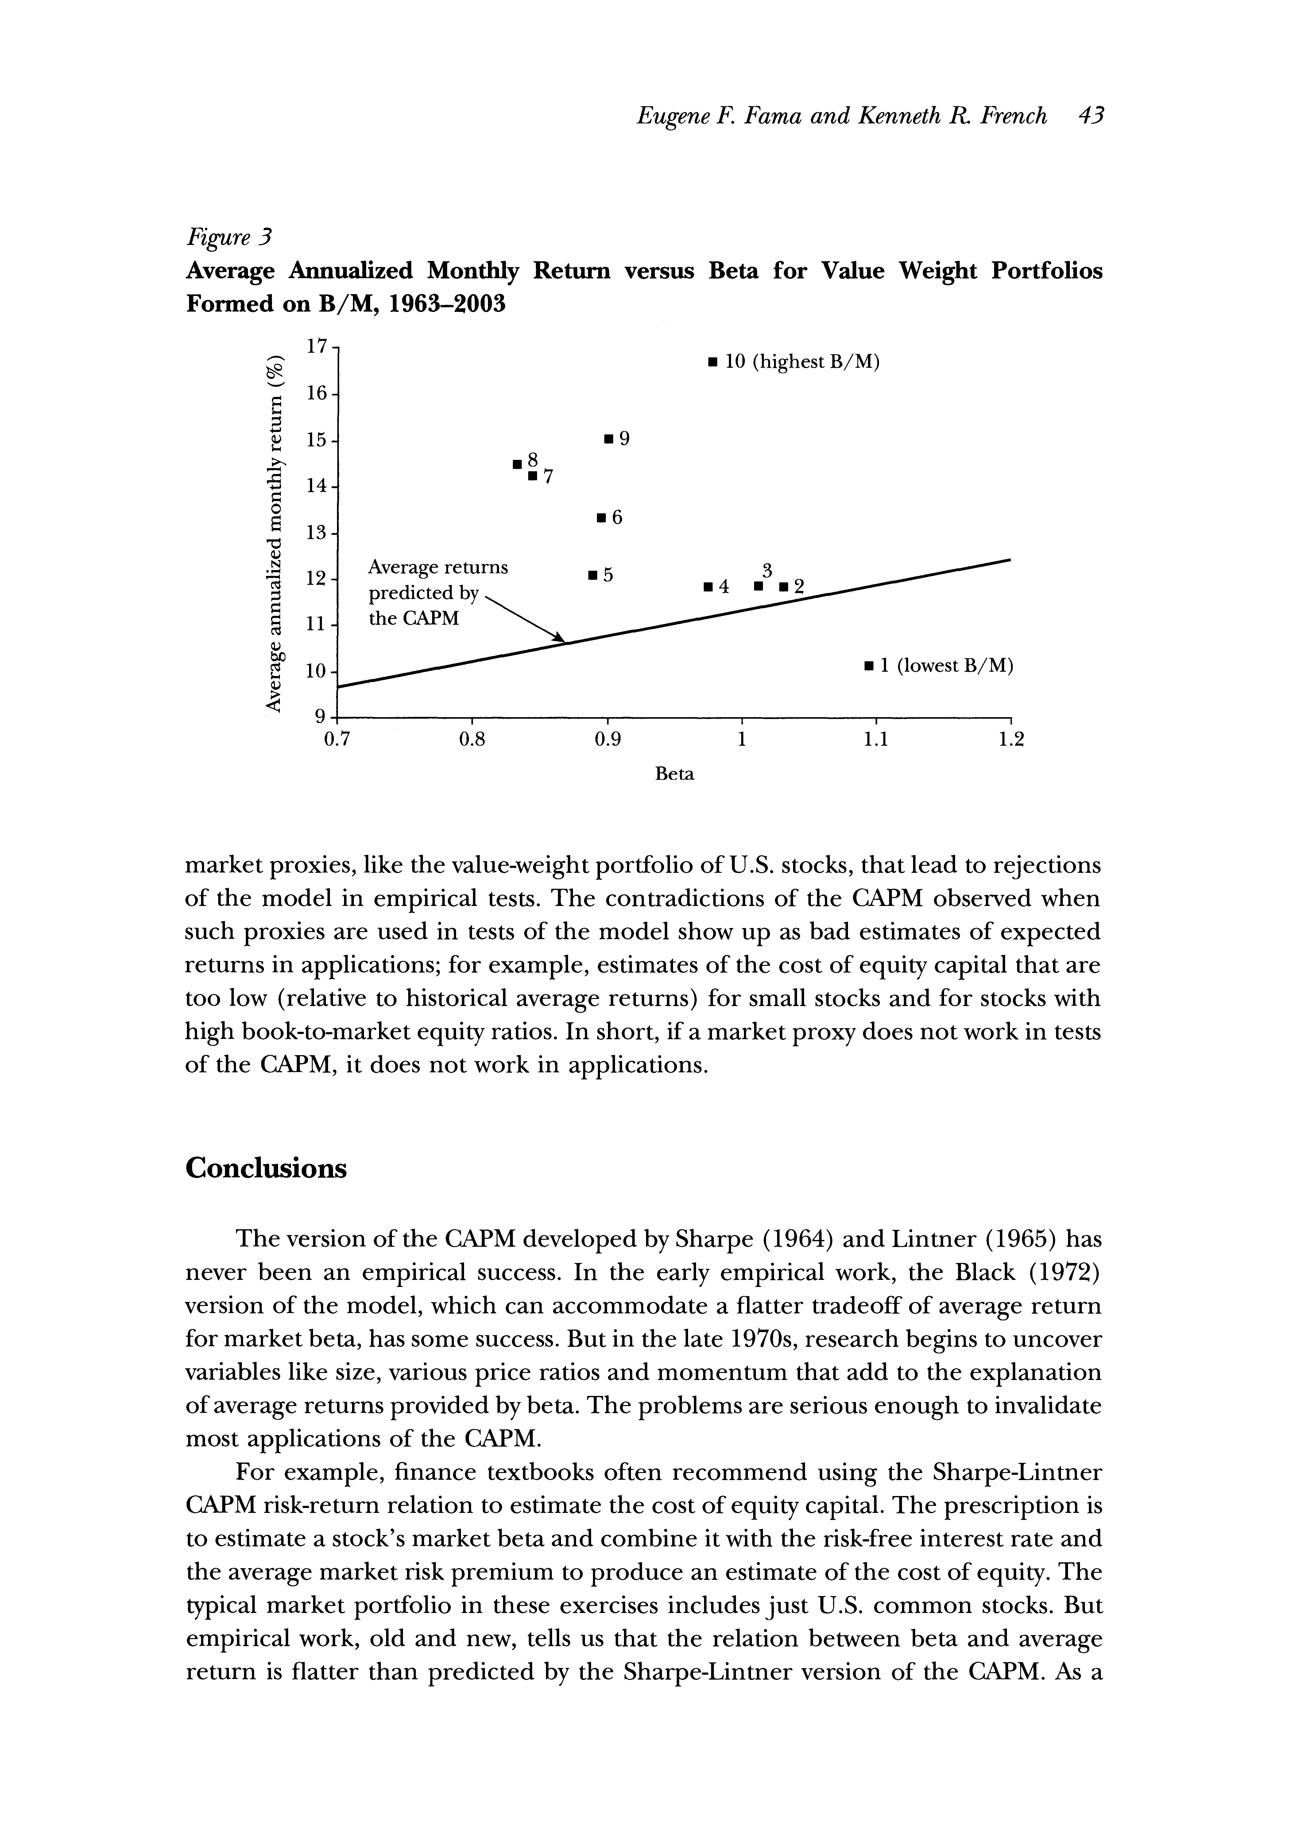
Fama and French Three-Factor Model
The Value Effect:

Slide 24
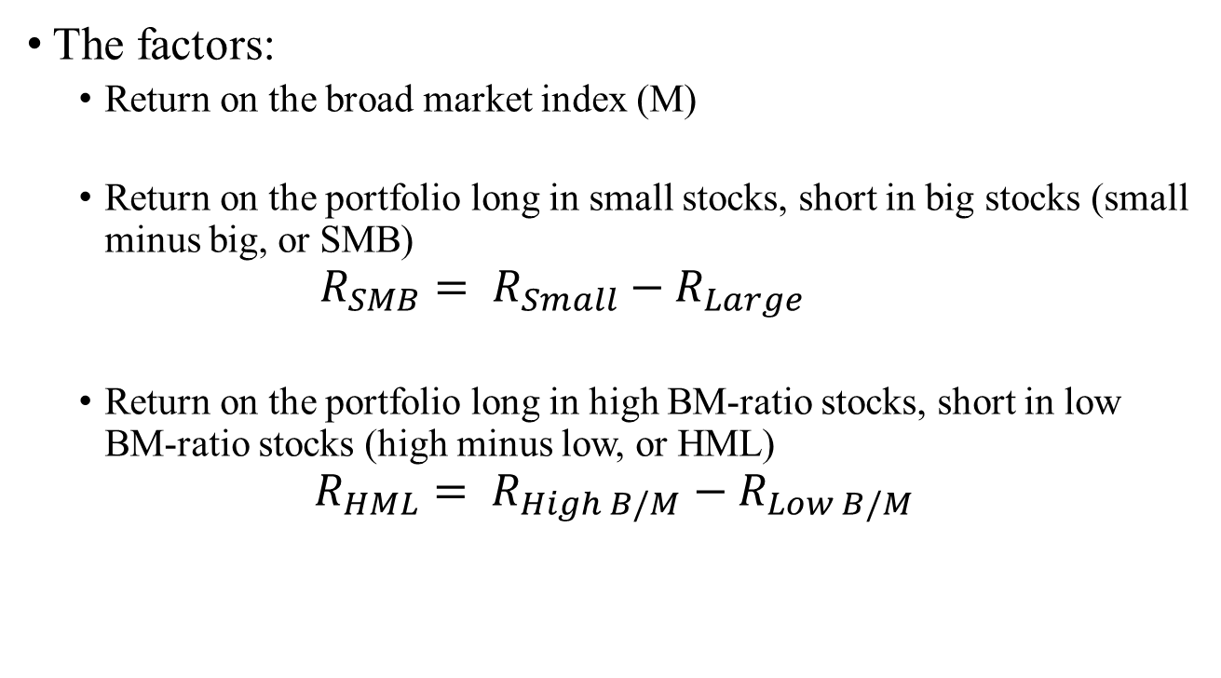
Fama and French Three-Factor Model
The factors:
Return on the broad market index (M)
Return on the portfolio long in small stocks, short in big stocks (small minus big, or SMB)
$${R_{SMB}= R}_{Small}−R_{Large}$$
Return on the portfolio long in high BM-ratio stocks, short in low BM-ratio stocks (high minus low, or HML)
$${R_{HML}= R}_{High B/M}−R_{Low B/M}$$

Slide 25
Fama and French Three-Factor Model
What do these factors measures?
Zero-investment factor mimicking portfolios
SMB: measure of “size risk”
small companies logically should be expected to be more sensitive to many risk factors as a result of their relatively undiversified nature and their reduced ability to absorb negative financial events.
HML: measure of “distress risk”
high B/M is usually an indication that their public market value has plummeted because of hard times.
would be exposed to greater risk of bankruptcy than their more highly valued counterparts.

Slide 26
Fama and French Three-Factor Model
Firm Characteristics or Risk Exposures?
According FF, it is not the Size or B/M of the company that requires higher returns
It is covariance with the risk factors that these Size and B/M based portfolio represent that matters, not the characteristic of the firm (Size or B/M ratio) itself
So, two equally-sized small companies would have different expected returns if their SMB loadings were different
Similarly, two value companies with equally high B/M ratios would have different expected returns if their HML loadings were different!

Slide 27
Fama and French Three-Factor Model
Is that really the case?
Daniel and Titman (1997)
Examine whether characteristics or covariances determine expected returns
Investigate whether portfolios with similar characteristics, but different loadings on the Fama and French (1993) factors, have different returns.

Slide 28
Daniel and Titman (1997)
After controlling for firm characteristics, expected returns are not positively related to the loadings on the market, HML, or SMB factors.
Their results indicate “that high book-to-market stocks and stocks with low capitalizations have high average returns whether or not they have the return patterns (i.e., covariances) of other small and high book-to-market stocks.”
Summary: Characteristics matter, not covariances with factor mimicking portfolios

Slide 29

Daniel and Titman (1997)
Mean excess returns of the 45 portfolios formed on the basis of size (Sz), book-to-market (BM) and the estimated factor loadings on the HML portfolio, for the period from July 1973 through December of 1993.
${\text{β}}_{HML}$
Characteristics rather than factor loadings that determine expected returns.

Slide 30
Daniel and Titman (1997)
D&T evidence supports the behavioral explanation (Lakonishok, Shleifer, and Vishny ,1994)
Investors incorrectly extrapolate past growth rates.
Also consistent with an agency explanation (Lakonishok, Shleifer, and Vishny, 1992)
Fund managers might be aware of the expected returns associated with value stocks, but nonetheless prefer growth stocks because these are easier to justify to sponsors

Slide 31
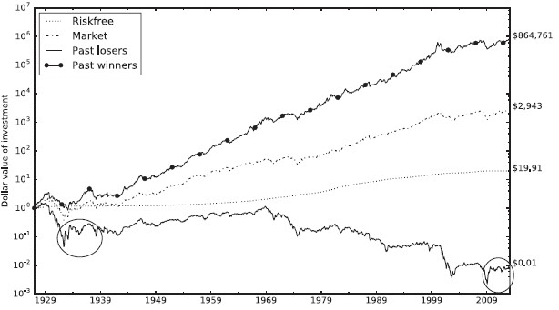
Momentum!
Jegadeesh and Titman (1993) find that past winners earned higher average returns than past losers.

Slide 32
Momentum!
Momentum is employed by most quantitative managers (Swaminathan, 2010 ).
Grinblatt and Titman (1989, 1993), Carhart (1997), and subsequent empirical work suggest that mutual funds also employ momentum.
Historically, momentum strategies deliver high premia.
Daniel and Moskowitz (2013) show that over the post WWII period, through 2008, the long-short equity momentum strategy had an average return of 16.5% per annum, a market beta of -0.125, and an annualized Sharpe ratio of 0.82.

Slide 33
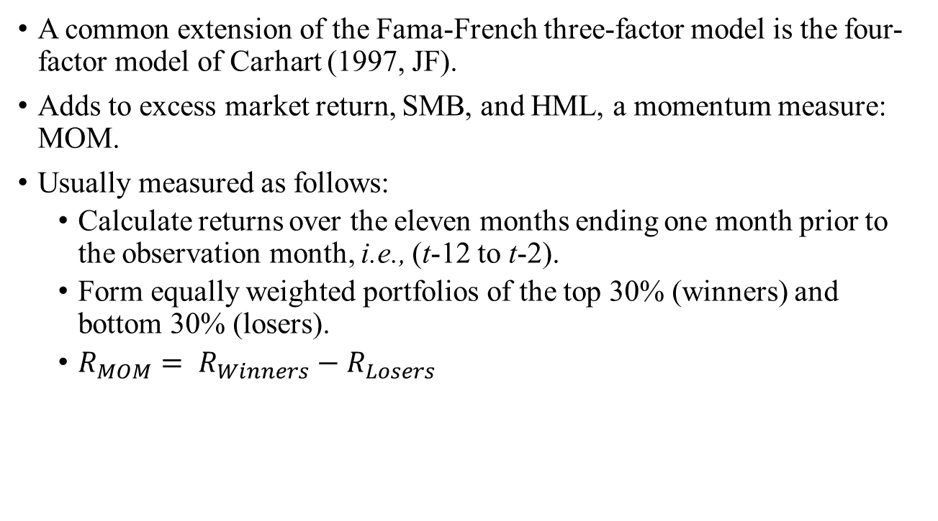
Carhart Four-Factor Model
A common extension of the Fama-French three-factor model is the four-factor model of Carhart (1997, JF).
Adds to excess market return, SMB, and HML, a momentum measure: MOM.
Usually measured as follows:
Calculate returns over the eleven months ending one month prior to the observation month, i.e., (t-12 to t-2).
Form equally weighted portfolios of the top 30% (winners) and bottom 30% (losers).
${R_{MOM}= R}_{Winners}−R_{Losers}$

Slide 34
APT vs. CAPM
APT looks like a multi-beta CAPM, with the expected excess return being the product of a beta showing the exposure to a risk source, and a F being the price of risk
also assumes frictionless markets, with shorting, borrowing etc
But the assumptions are different:
APT places no restrictions on what the factors are nor on the price of factor risk exposure
multi-beta CAPM requires that factors enter into utility functions and economics may well suggest plausible ranges or signs for factor prices
CAPM is an equilibrium theory so “uneconomic” agents will change the result; APT makes no assumptions about other players
However, tendency to give economic interpretations to factors blurs distinction …

Slide 35
APT vs. CAPM
APT is more general in that it gets to an expected return and beta relationship without the assumption of the market portfolio.
APT can be extended to multifactor models.
There is exactly one well-diversified portfolio in the CAPM: the market.
There can be more than one in the APT.

Slide 36
Summary
Two approaches to risk-return:
equilibrium model of CAPM and derivatives
factor models such as Market model and APT
Equilibrium models identify the “factors” and justify why they should attract a premium – gives more confidence that premium will persist
Factor models unconstrained in choice of factors, so can fit data more readily, but do not explain why they should attract risk premia
Both types of model imply a distinction between systematic and idiosyncratic risk, with the latter not being rewarded
No consensus about the “right” model
Key issues in applying models (beta estimation, estimation of risk premia) common to all
Reading: BKM Chs 9-11

